Slide 1

New York Housing Price Prediction
Under the Guidance of Dr. Chaojie Jay Wang
- Rahul Kaushik Mallela (OO29854)

Slide 2
Introduction
This project demonstrates our method for predicting New York real estate prices, designed to help stakeholders like buyers, sellers, and agents make better decisions for purchasing the property.
analyzed a detailed dataset, focusing on essential features such as bedrooms, bathrooms, square footage, locality and Sub locality to estimate property prices.
Using data in the dataset, models identify key factors affecting property values and utilize regression techniques like Linear, Lasso, and Ridge for accurate predictions.
findings provide valuable insights into market trends, aiding in strategic investment planning and enhancing market transparency.
Notes:
In this project, I aimed to predict real estate prices in New York to help buyers, sellers, and agents to make informed decisions. I analyzed a dataset with key features like bedrooms, bathrooms, square footage, and location. Using regression techniques, I identified factors affecting property values and provided insights into market trends.

Slide 3
Dataset Overview
The dataset contains 4,801 entries and 17 features.
Dataset is Sourced from Kaggle with the Source link https://www.kaggle.com/datasets/nelgiriyewithana/new-york-housing-market
Key Features of the dataset are:
Price (Listings price of the property)
Bedrooms, Bathrooms, PropertySqft (Number of Bedrooms, Bathrooms, and Total Square Footage of the Property)
Location Details (includes State, Address, Locality and Sub-locality)
Notes:
dataset has 4801 entries and 17 features, sourced from Kaggle. Key features include:
Price (Listing price)
Bedrooms
Bathrooms
Property Square Footage
Location details (State, Address, Locality, and Sub-locality)

Slide 4
Data Pre-processing
Data Cleaning : Handling the missing and Null Values, Detection and Removal of Outliers
Feature Engineering : New Feature is created by the name of ‘Price per sqft’ to enhance model prediction, which divides the price per property Sqft.
Data Transformation : One-hot Encoding is used to convert categorical variables into a numerical format that could be processed by machine learning algorithms.
Feature Selection : features were selected based on their importance.
Notes:
Cleaned data by handling missing values and removing outliers.
Created a new feature called 'Price per sqft' for better predictions.
Used one-hot encoding to convert categorical variables into numerical format.
Selected important features for our models by using feature selection.

Slide 5
Data Analysis ( EDA )
Distribution Analysis : Analysis of the distribution of Key numerical features like Price, Beds, Bath, PropertySqft by generating histograms, bar plots to identify any skewness or outliers.
Correlation analysis: Correlation between various features to identify relationships between different variables, particularly how other features in the dataset relate to the ‘PRICE’.
Count and Bar plots : Utilization of count plot to examine categorical data such as property types and the bar plots to show number of bedrooms.
Creation of ‘Price_per_Sqft’ feature to evaluate how property values scale with size across different property listings, histograms and scatter plots were used to identify the relationships further.
Notes:
Analyzed the distribution of key features using histograms and bar plots to identify any skewness or outliers.
Examined correlations to understand relationships between variables, how other features in the dataset relate to the Price, as it is the target column.
Used count and bar plots for categorical data like property types.
Created 'Price per sqft' to see how values scale with size across different property listings.

Slide 6
Model Selection
A variety of regression models were evaluated to identify the best performer for predicting housing prices, including Lasso, Ridge, and XGBoost among others.
Random Forest was used to determine the importance of various features, helping to select the most relevant predictors for inclusion in the final models.
Models were assessed using key performance metrics such as RMSE and R-squared values, which provided a measure of accuracy explained by the model.
Hyperparameter tuning was conducted using techniques like RandomizedSearchCV to optimize the models for better performance..
The model was trained on the 80% of the data and the remaining 20% is used on the test set, which is used to select the best performing model.
Notes:
I tested various regression models, including Lasso, Ridge, and XGBoost. Random Forest was used to identify important features which will help the model. Models were evaluated using RMSE and R-squared values. After tuning hyperparameters, XGBoost emerged as the best model.

Slide 7
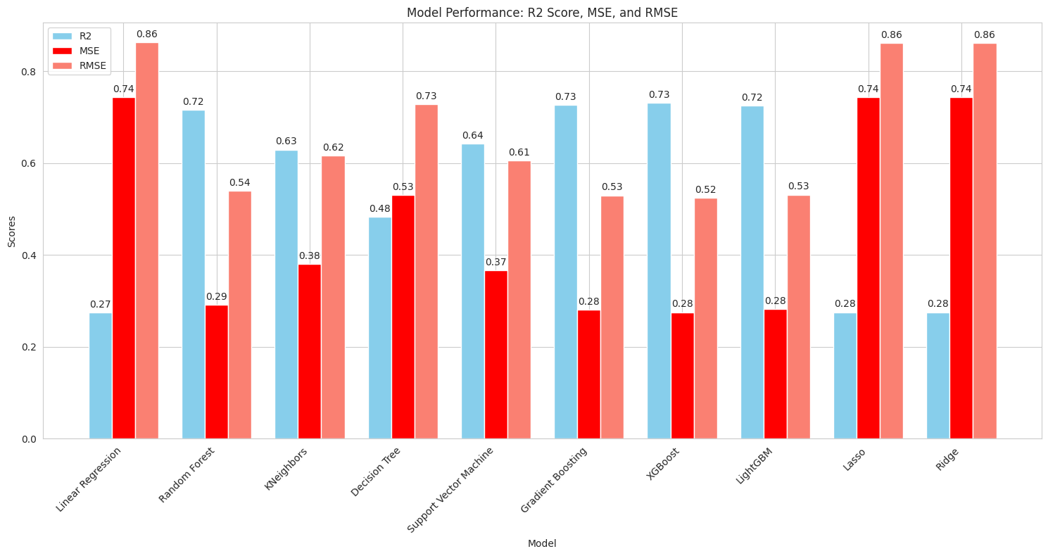
The best performance model is XGBoost Regressor
Notes:
It’s the graphical representation of all the models that are evaluated using the R -2 squared, Mean Square error and root mean square error, and from this XGBoost emerged as the best model.

Slide 8
Website Description
Website was designed as a user-friendly using the Streamlit app, this app creates a web app which helps for predicting the house prices based on the trained model.
The website is designed, allowing users to easily input features like number of beds , baths, Property Sqft.
The website provides straightforward options for users to increase and decrease the number of bedrooms, bathrooms, etc.
Users can receive an estimated price instantly by clicking the "Predict Price" button after entering property details..
After predictions, the website displays the estimated total price, offering a valuable metric for comparison.
Notes:
I built a user-friendly website with Streamlit to predict house prices. Users can input details like beds, baths, and square footage. By clicking "Predict Price," they get an instant estimate and see the total price for comparison.

Slide 9
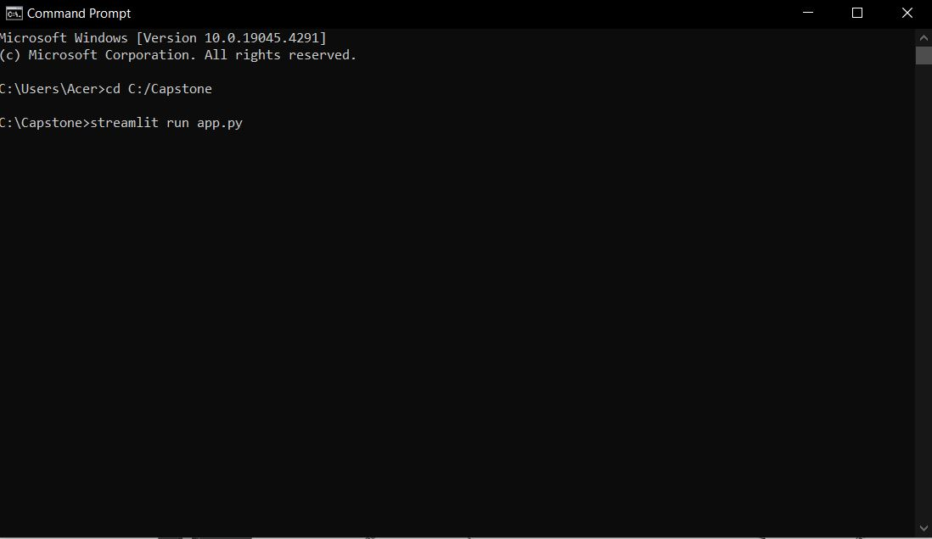
We give few commands in the command prompt to run the Streamlit app

Slide 10
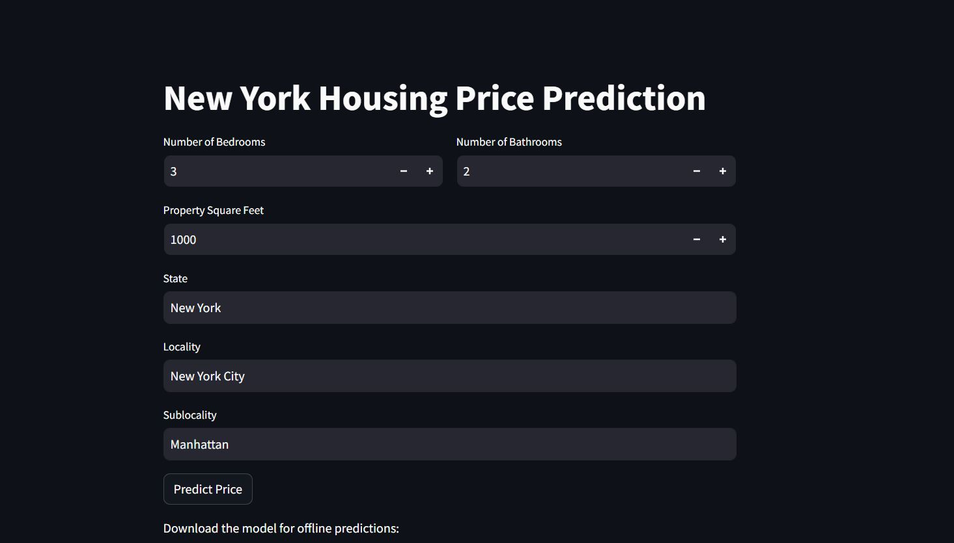

Slide 11
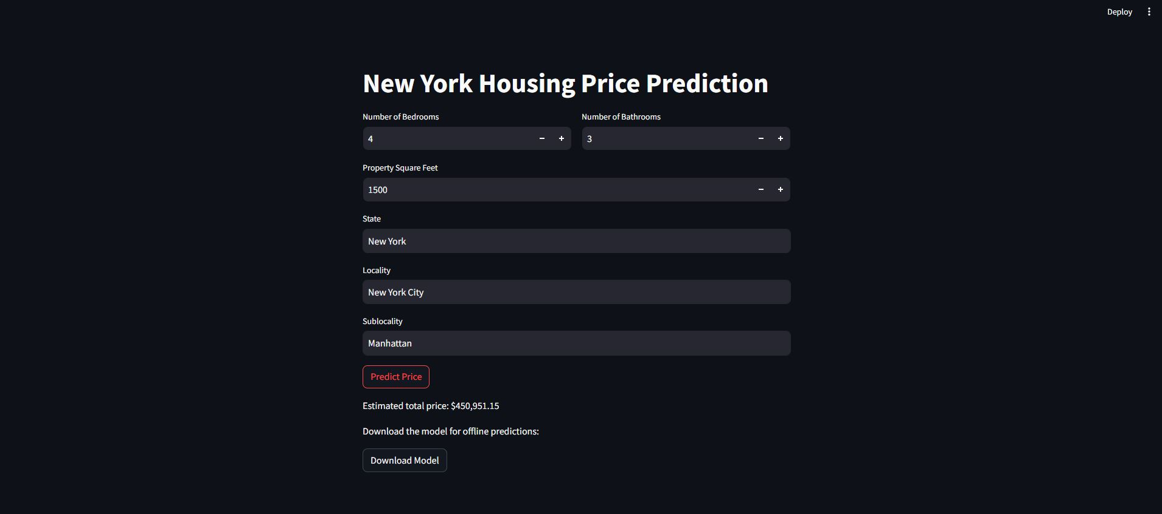

Slide 12
Conclusion
Identify Key trends by created a predictive model that uses machine learning algorithms to estimate housing prices in new York.
Performed Machine learning techniques and selected XGBoost as the best performance model.
Developed a user- friendly app using Streamlit, which simplifies the process for buyers and sellers to get practical price estimates regarding the property listings, which provides transparency in the market.
Future Scope: Plan to enhance model’s accuracy by incorporating real time data, which further bridges the gap between everyday real estate transaction.
Notes:
At last, I created a model that predicts New York housing prices using machine learning, with XGBoost being the top performer. The Streamlit app makes it easy for users to get price estimates, bringing transparency to the market. In the future, I plan to improve accuracy with real-time data.

Slide 13
Thank you

